Slide 1

Implementation and Use of the Idaho Department of Water Resources Telemetry Networks
Presented by : Stuart Van Greuningen
Michelle Richman
Date: June 8, 2015

Slide 2

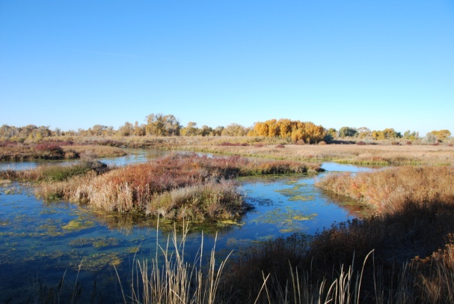
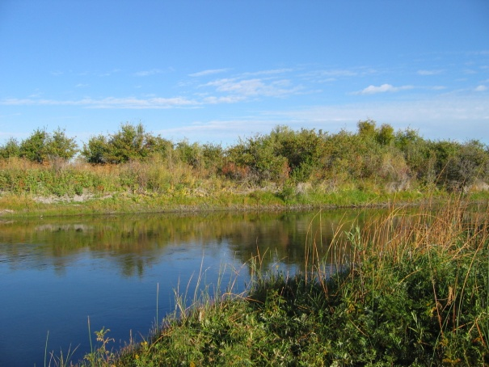
Background
Started in 2007 with the down turn in the economy. At that time we had most of our monitoring work contracted out and those contracts were brought in house to reduce costs. At the same time the Legislature passing of the Strawman Proposal and later through the creation of the Comprehensive Aquifer Management Plan (CAMP) funds were given to the department for monitoring work.
In 2008, chose Intermountain Environmental as vendor for Campbell Scientific equipment.
Had initial training of IDWR personnel in July of 2008 and installed first station in the Hagerman area at that time with telemetry added later.
Head waters spring complex – Ft Hall
Clear Creek – Ft Hall

Slide 3
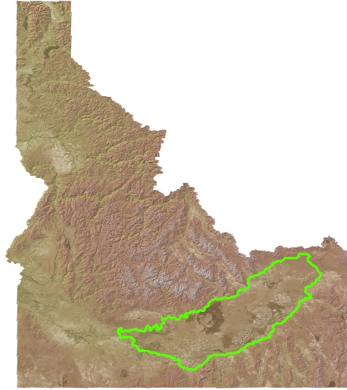
Focus Area
Eastern Snake River Plain
Largest agriculture area in the state producing approximately 33% of all goods and services.
Declines in the aquifer are causing numerous water conflicts between groundwater users and surface water users.

Slide 4
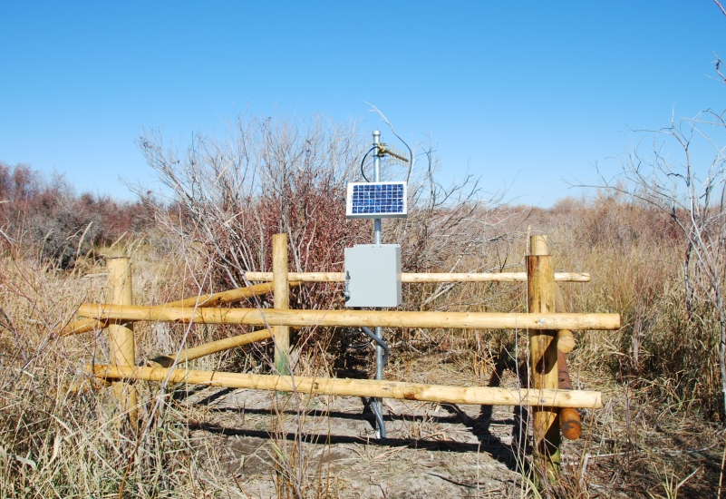
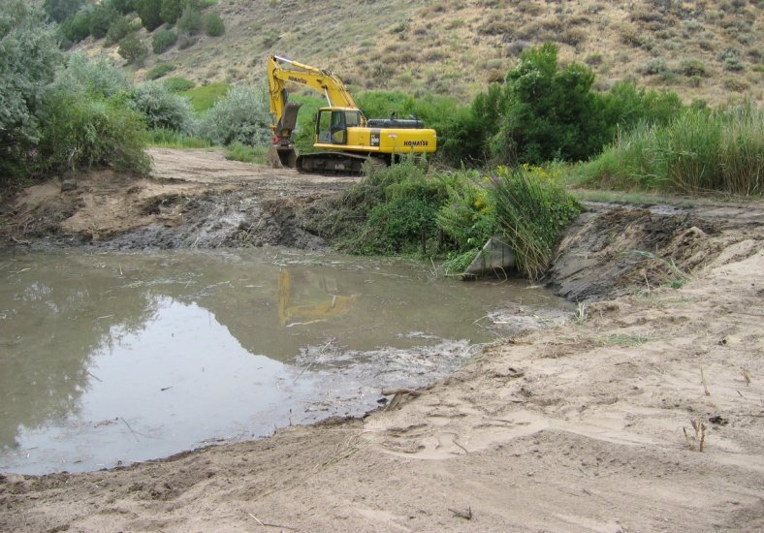
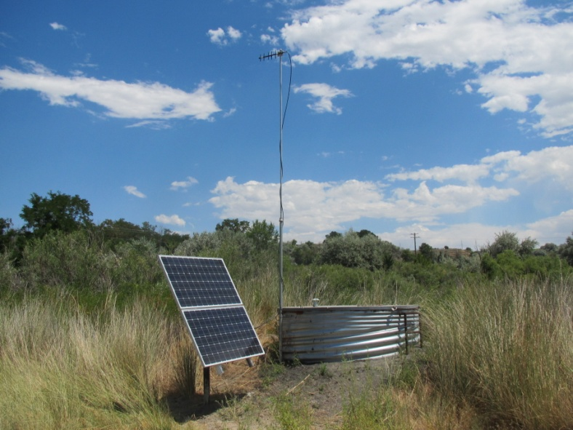
Installations
Clear Creek site Ft Hall Bottoms
Site Rehab at Blind Canyon in Hagerman Valley
Majority of installations are radio with cell modems used at more remote sites or in areas where radio communication is encumbered.
Tucker site Hagerman Valley

Slide 5
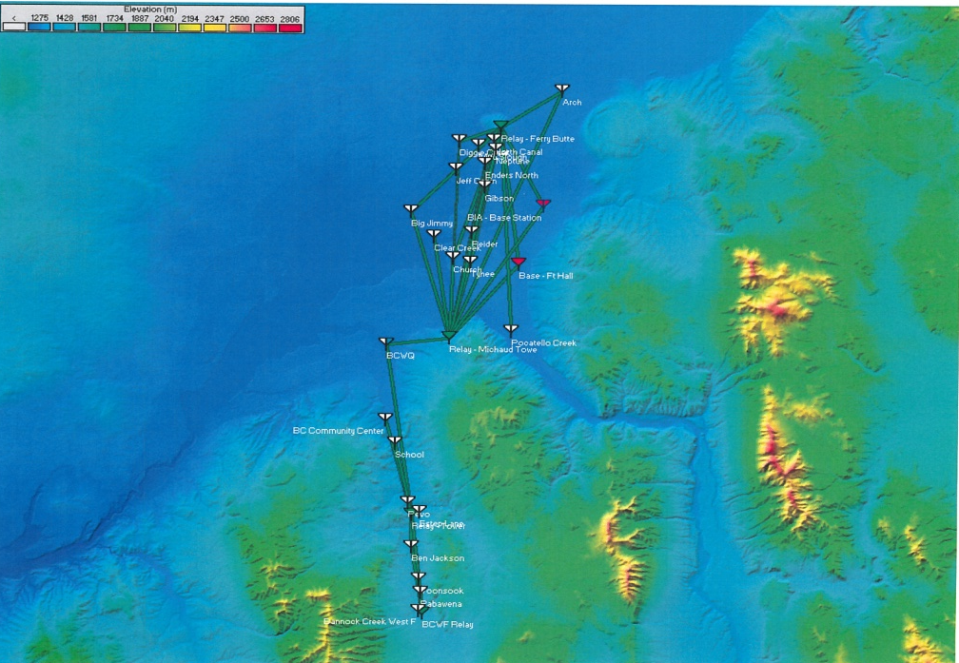
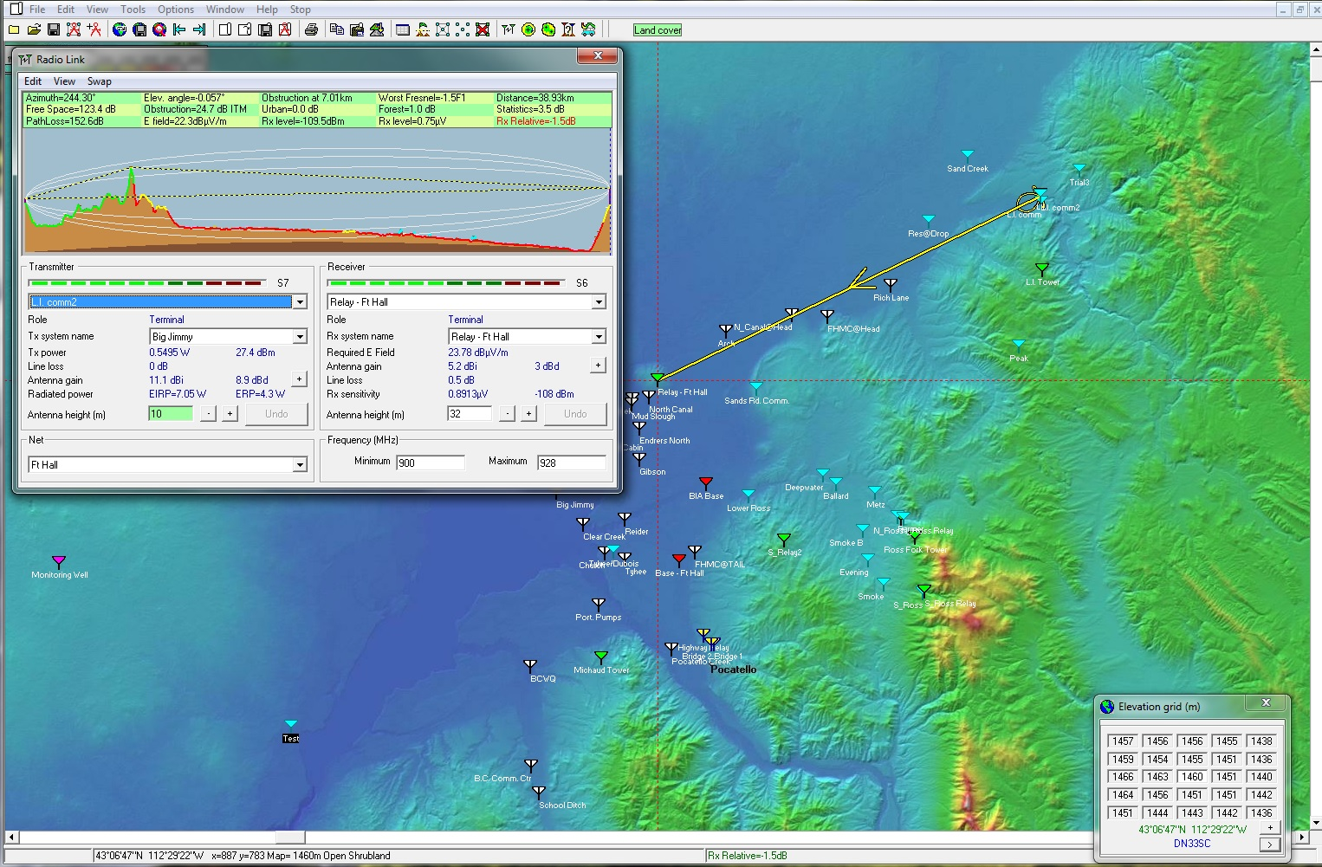
Installation –Tools
Radio Setup
Use mobile radio setup for radio sites.
Radio Mobile Program (free software)
Cell Modem Setup
Squid Pro used for cell signal strength and carrier.
Radio Mobile screen captures

Slide 6
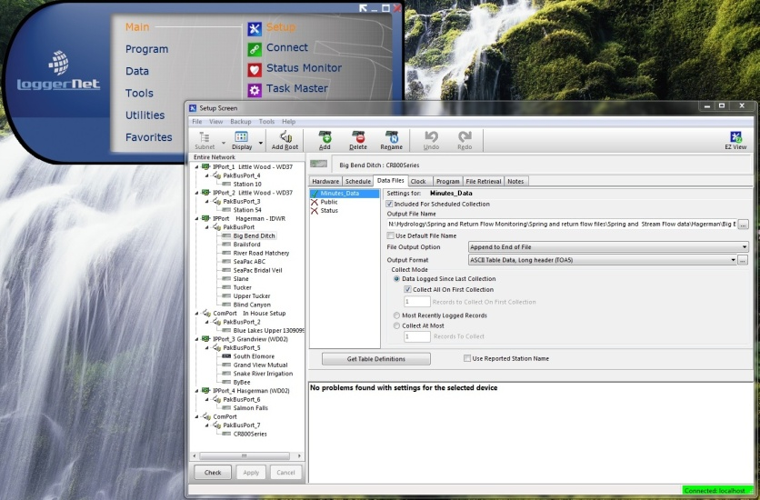
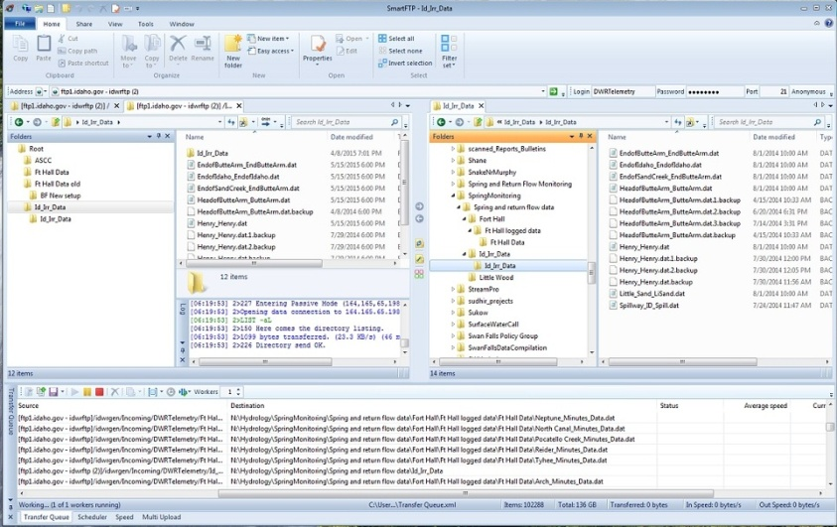
Data Collection
Sensor output is read every 15 seconds or at the appropriate time frame for equipment being used and averaged over 15 minutes, then downloaded to base every hour using Campbell Scientific (CS) LoggerNet.
Cooperative sites are similar except that they send data to their base location and then to our office via SmartFTP. We encourage cooperator to use CS equipment but not mandatory.
Try to stay close to USGS standard for data collection.
LoggerNet screen capture
SmartFTP Screen capture

Slide 7
Telemetered Monitoring Sites Across
the Eastern Snake River Plain
Currently 53 sites with 42 scheduled for installation in the next 2 years.
Water District 02 15 sites with 40 additional scheduled within the next 2 years
Hagerman Valley 9 site with 2 scheduled for installation this summer
Little Wood River 2 sites
Cooperatives 12 sites
Ft Hall 15 cooperative site, 80 sites operated by the Sho-Ban Tribe which have been installed and are maintained with the assistance of IDWR staff, 10 additional sites to be installed this year for the Tribe with 2 additional cooperative sites to be installed in 2016 - 2017

Slide 8
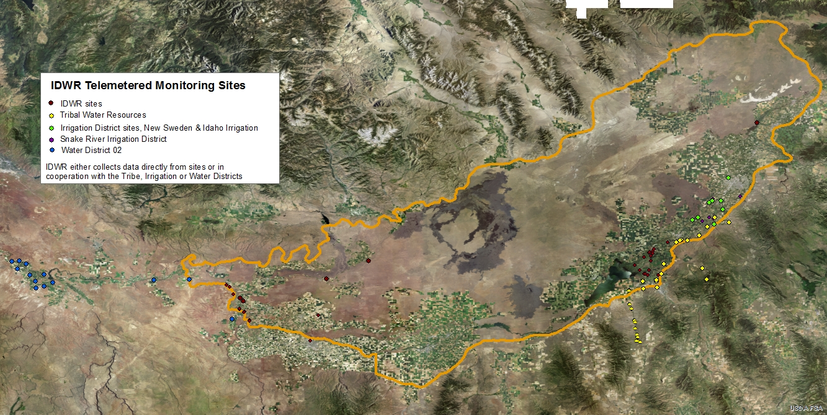
IDWR Telemetered Network

Slide 9
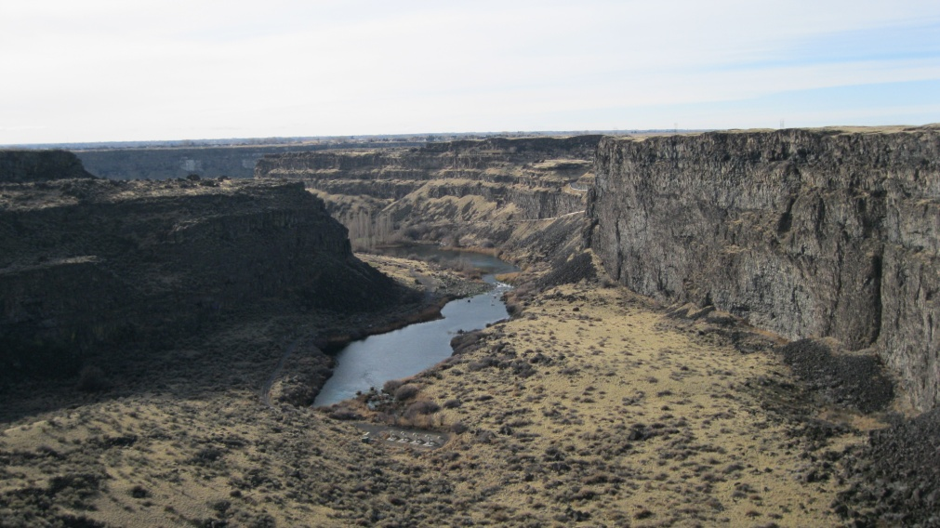
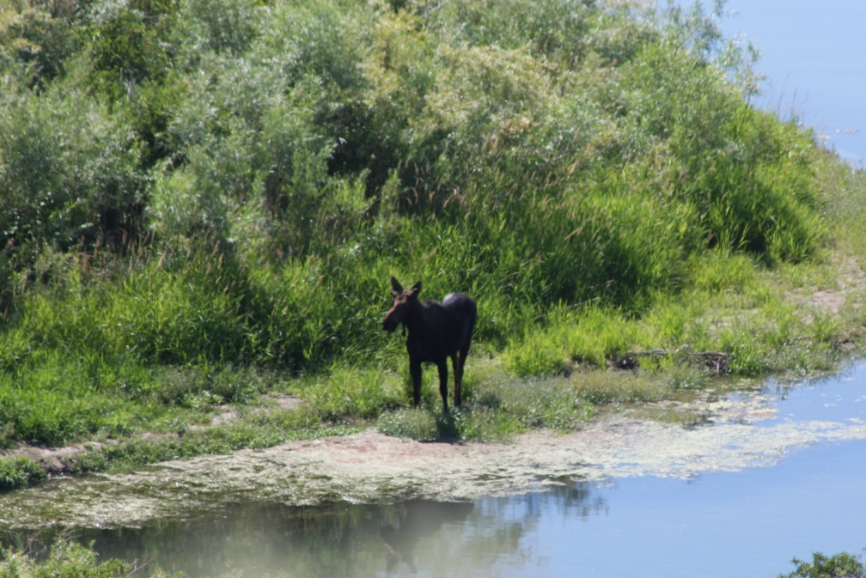
Problems encountered
Hardware from vendor
  Hardware package had wrong cable
Transducers
  Signal drift, non-repeatability
Signal interference – spread spectrum radios
  Signal blocking all 900 MHz signals
Low frequency VHF radios
  Selecting the right frequency
Rough terrain – Snake River Canyon
Moose – Portneuf River, Ft Hall

Slide 10
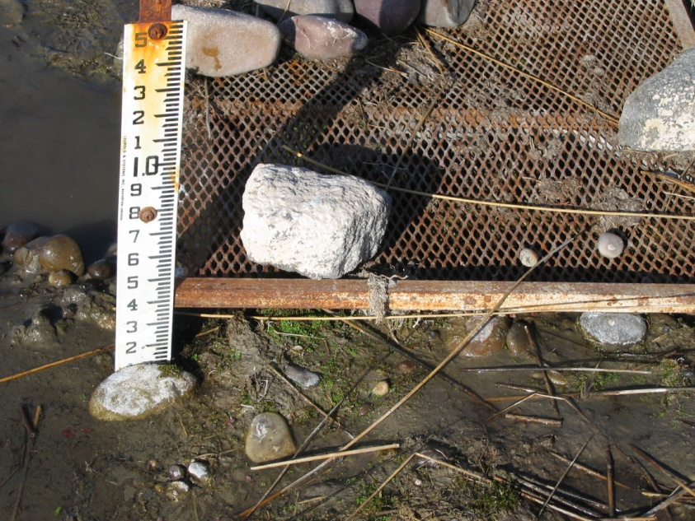
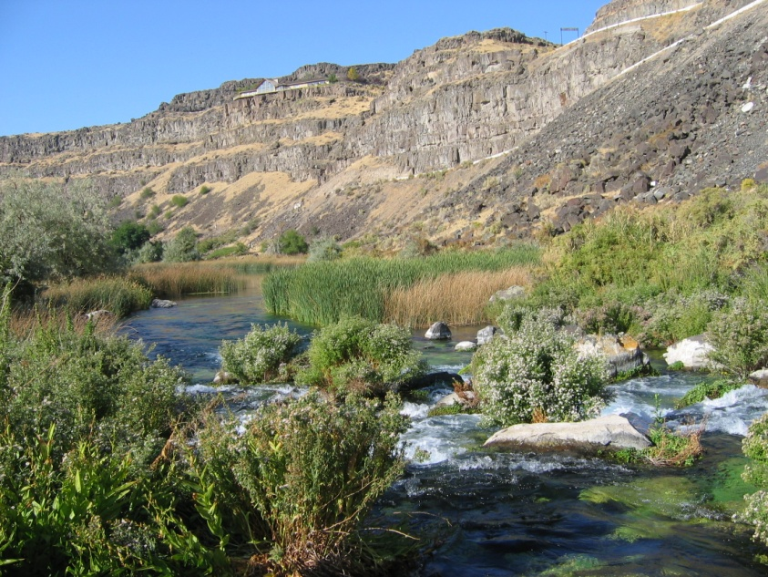
Problems encountered
Locating equipment / antenna positions
  Snake River Canyon
  Trees
  Buildings/Air conditioners
Animals
  Chewing wires, knocking over stations
Site Acquisition
  BLM permissions for relay tower
  Multiple Base Stations
    Adding a multiple base stations to receive data
    Changing stream conditions
    Stream channel shift
Stream Channel change – Ft Hall
Blue Lakes weir site –Snake River canyon near Twin falls

Slide 11
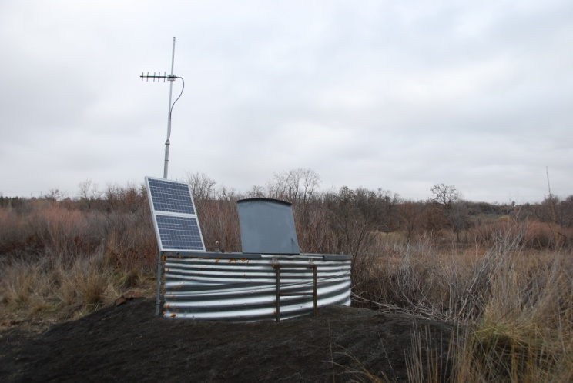
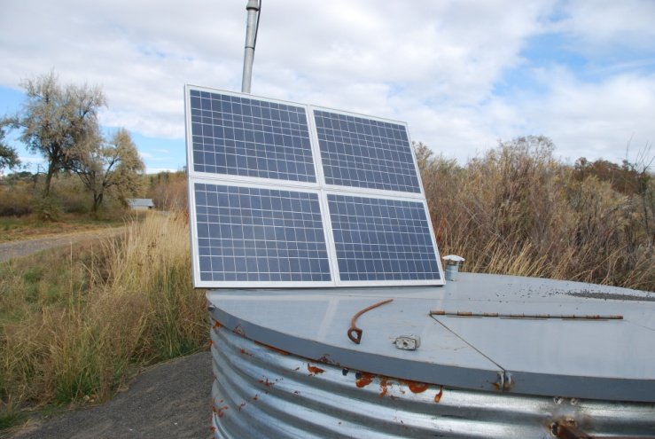
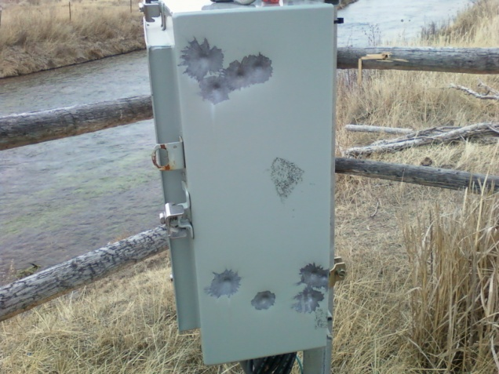
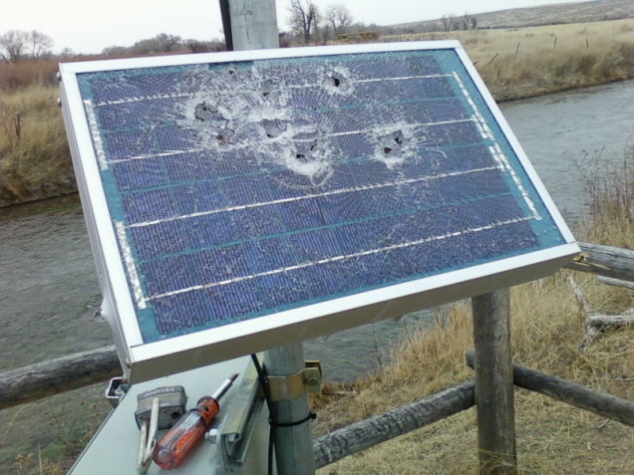
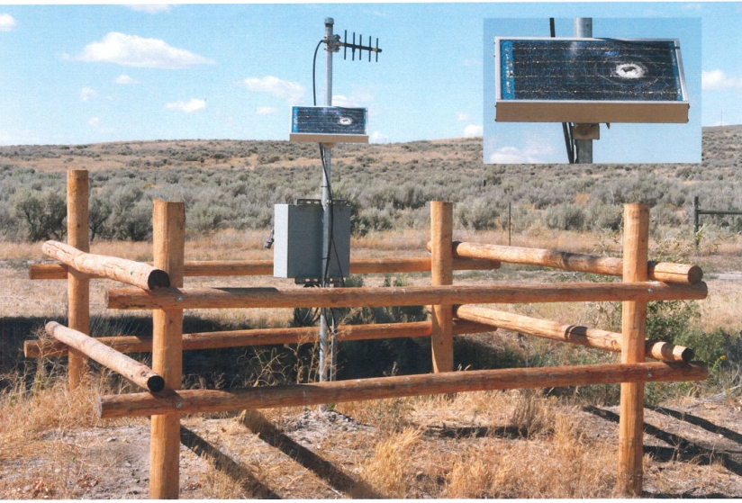
Problems Encountered
Solar Panel Sizing
Vandalism

Slide 12
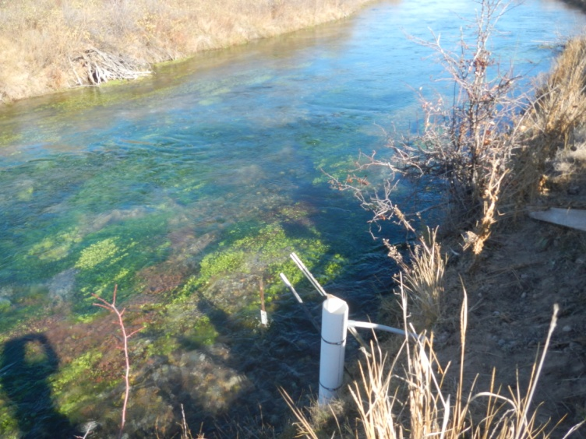
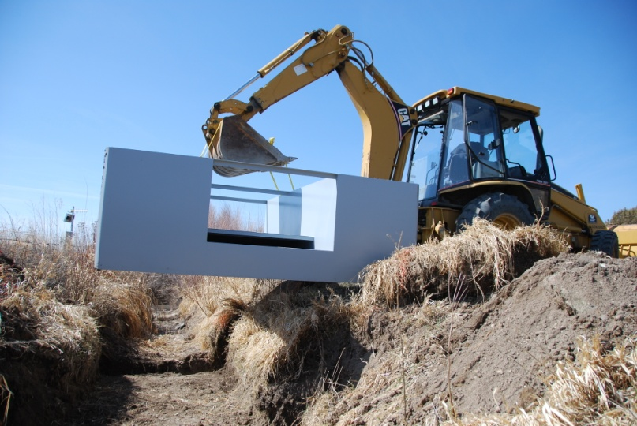
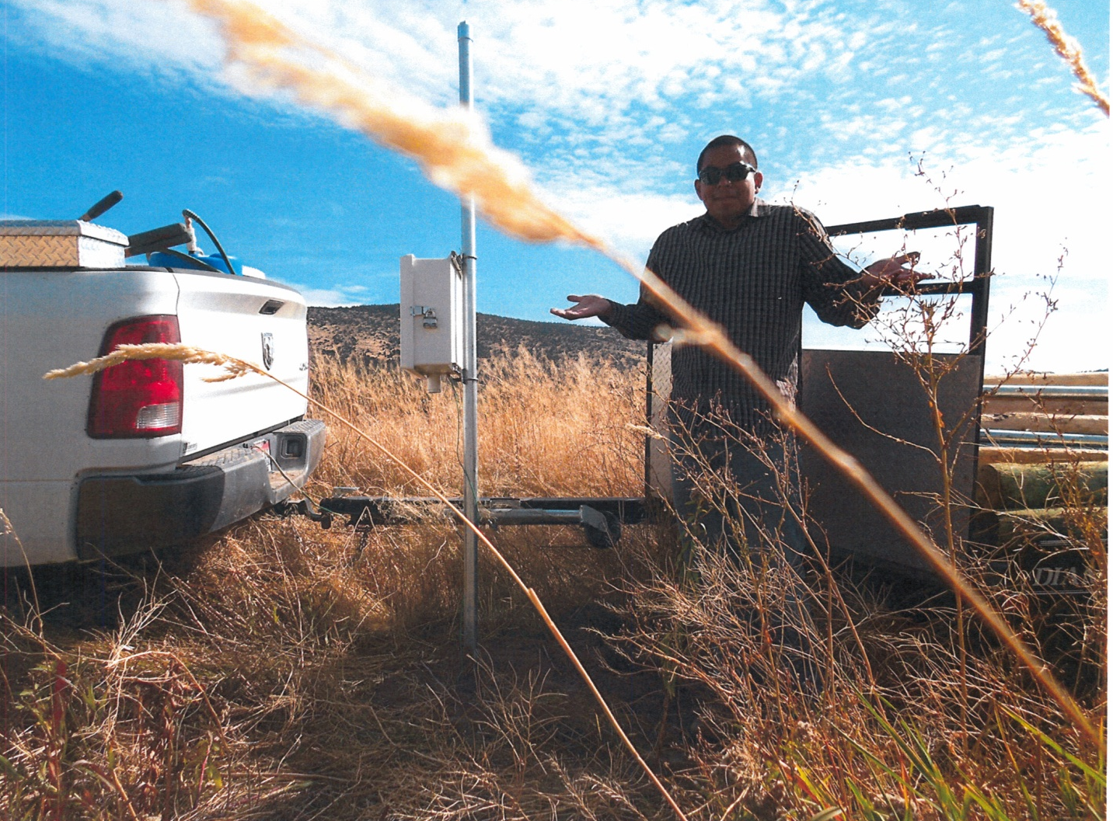
Problems encountered
Installation, aquatic growth, abnormal water deliveries, human error

Slide 13
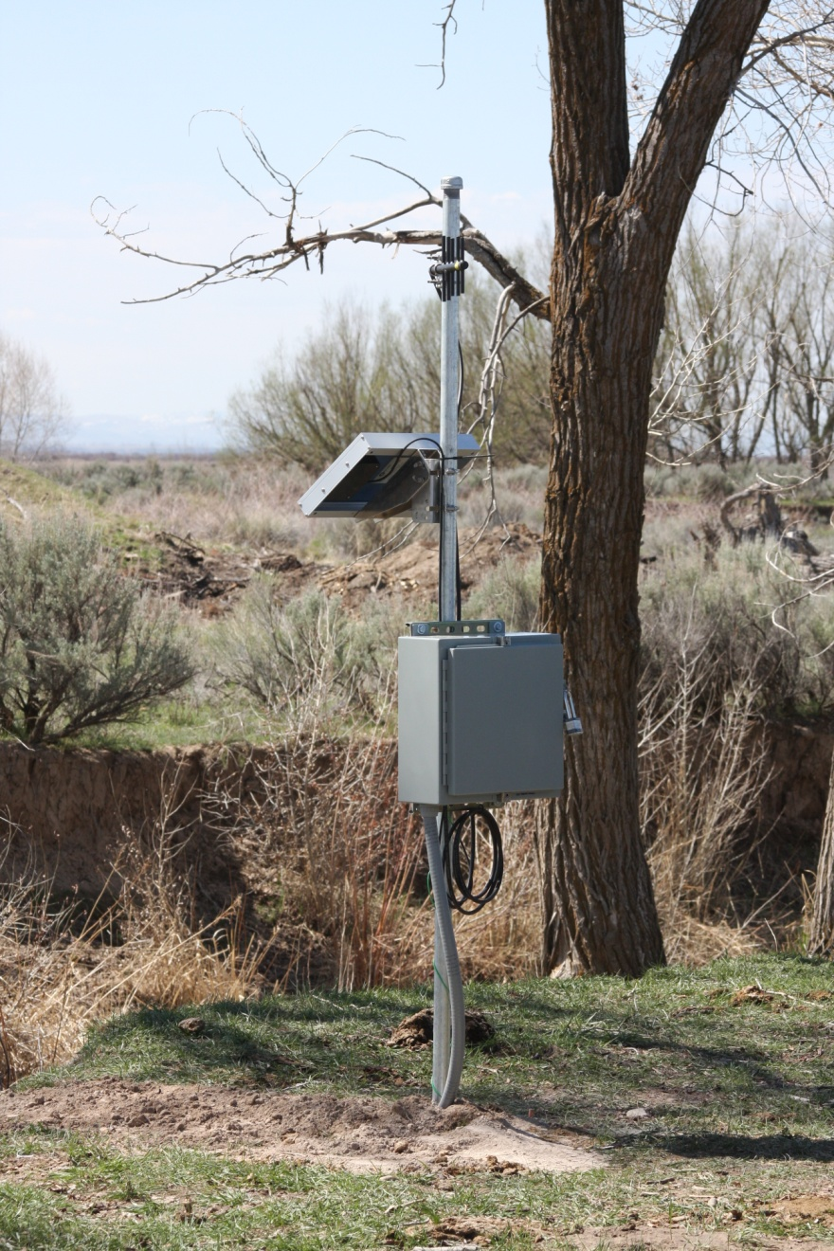
Station Costs and O&M
COSTS
Stations run between $2800 - $3500
Includes data logger, radio, battery, antenna, pressure
transducer and associated equipment
Additional costs come when other type of monitoring
equipment are used, these are generally magnetic
meters, ultra sonic meters, etc. ($3000 - $10,000)
Additional costs also show up if structures are required
for measurement ($4000 - $50,000)
O&M
Typically minor costs associated with radio stations
Cell modems have monthly fees for service but the cost of the cell modem is about ½ of what a radio costs
Starting to see replacement costs for batteries and transducers which run around $85 and $780 respectively
Largest expense is monthly or bi-monthly visit to sites
North canal – Ft Hall

Slide 14
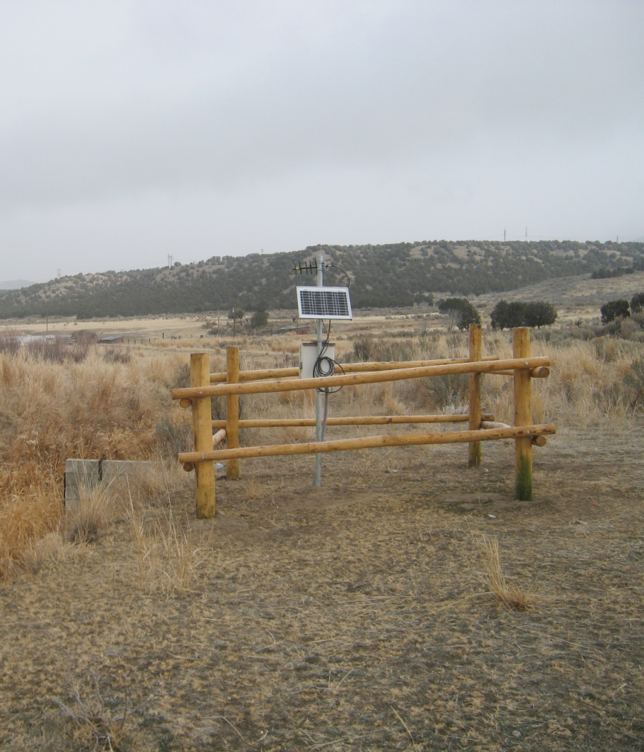
Funding
Legislature provided funding for monitoring work initially through the Strawman Proposal and then again through CAMP, this funding ended in 2014.
Funding for equipment will now come from the Aquifer Management Fund.
Water Districts are beginning to have the grower pay for monitoring equipment. This is being done with the help of the Idaho Water Resource Board who sponsors a Water Smart Grant to help reduce overall cost of equipment and installation. Grant typically covers between 35% - 45% of equipment and installation.
Woonsook site – Arbon valley

Slide 15
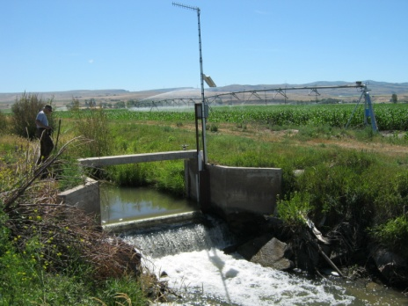
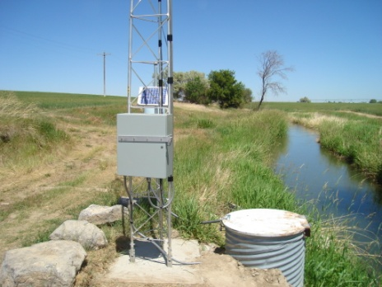
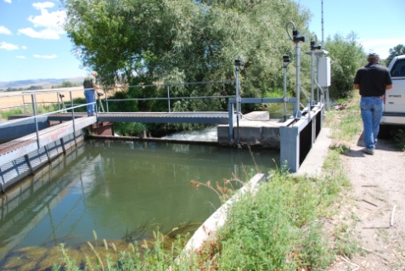
Accomplishments
Cooperation between IDWR and Irrigation Districts
Relationship with the Sho-Ban Tribes
Helps State in meeting Nez Perce Agreement requirement
Better data for modeling efforts

Slide 16
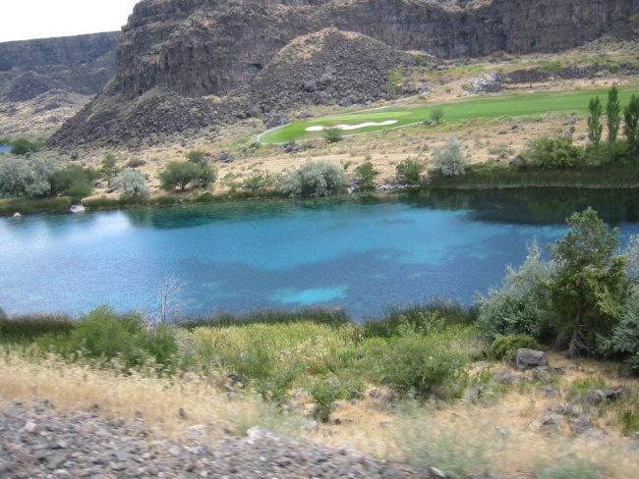
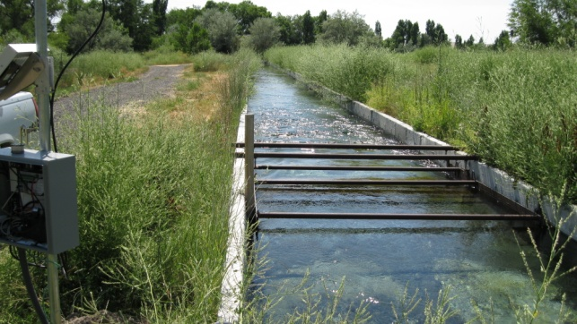
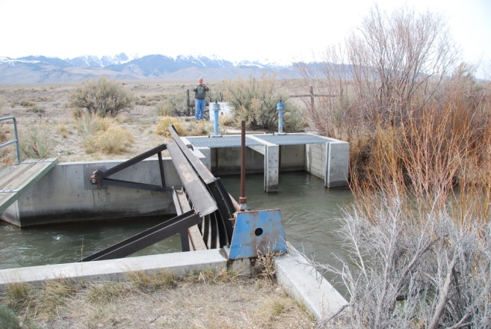
Where are we headed …
Hiring a technician to work full time on telemetry and monitoring equipment
Broaden our telemetered network by working with other entities
Add other areas of the state and possibly some remote groundwater wells
Use for managed recharge sites to monitor input and equipment control
Streamline data processing using Aquarius Server…

Slide 17
Background on our Data Processing
Prior to 2007, all processing done with MS Excel
In 2007, began using Aquarius Workstation
+ more powerful tool for correction of time series data
+ greatly improved rating curve development
- manual importing to append data
- file management is crucial
In 2014, began using Aquarius Server
+ all of the benefits of Workstation
+ imports and exports automated
+ no more file management
+ hydrographs automatically updated
+ minor data corrections automated
Offset correction
Drift correction
Notes:
Hi there. So, as Stuart has been describing, a huge part of the battle is just getting the telemetry network up and running. The next hurdle is having the channels in place to accept and manage the incoming data, and that is where Aquarius Server steps in.
Excel
To give you some background, prior to 2007, all of our data processing was done in Excel, which offers a very static approach to data processing. It relies heavily on good file management. Appending new data to old data is a very manual process in Excel, and the program has limited functionality for rating curve development and data correcting (see examples). An offset correction shown at the top is easy to do in Excel, while the drift correction shown below it is not so easy.
Workstation
Moving forward to 2007, we began using Aquarius Workstation (developed by Aquatics Informatics in Vancouver, BC).
Aquarius Workstation is a much more powerful tool for correcting time series, because you’re able to visualize the corrections as you make them. As Stuart mentioned, drift has been an issue we’ve faced with the pressure transducers, and it’s very simple to correct for that in Aquarius Workstation.
Aquarius Workstation is also a very powerful tool for rating curve development.
The main drawbacks of Workstation are that data appends still need to be done manually, and (as with Excel) file management is still an issue.
Server + Workstation
Finally, in 2014, we started using Aquarius Server in conjunction with Aquarius Workstation, which provides a much more dynamic approach to data processing!
(To quote the technical support folks, “Aquarius Server has its own server-side database, and users access the data through a web-browser based user interface.”)
Aquarius Server has all of the benefits of Aquarius Workstation, plus automation of several tasks.
There is no more manual importing and exporting of data.
File management is a no longer an issue.
And hydrographs are automatically updated. Even minor corrections, such as gap filling can be automated.
Cost:
Workstation $14875
Custom Rpt $2000
Server $7000
-----------------------
Total $23875
S&Maint $6623/yr

Slide 18
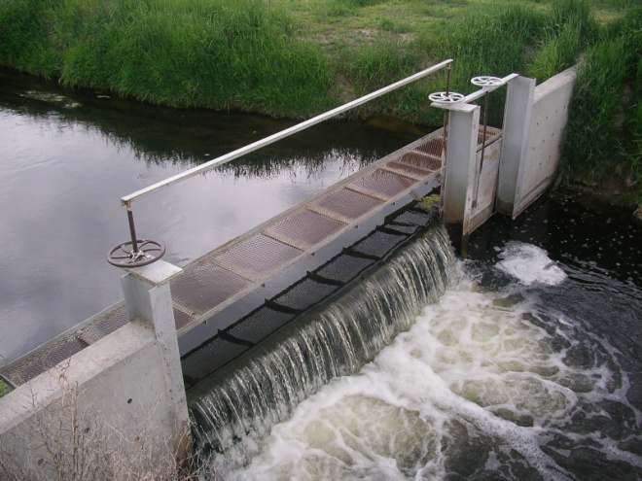
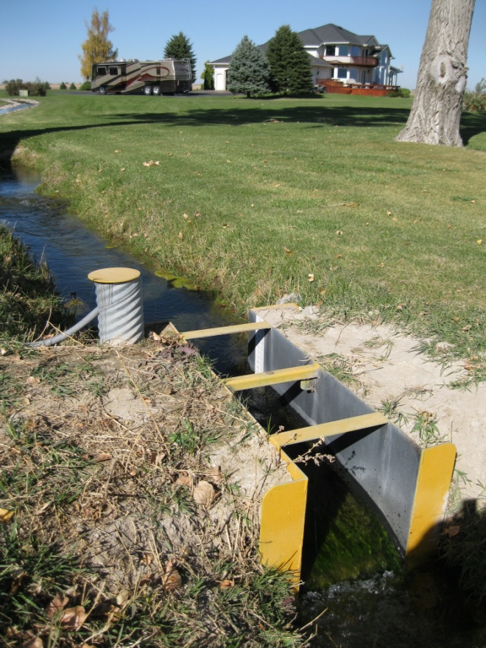
Additional Benefits of using Aquarius Server
+ Conduit for telemetry data
+ Real-time data for sites
+ Easier exchange of data with our partners:
USGS, Idaho Power Company, irrigation districts, tribes, federal and private hatcheries, etc.
+ Time Savings as data are automatically “ingested”, appended, processed, and exported
+ Saves an estimated 3 to 5.5 hours/site/year
+ For 80 sites, that’s 30 to 55 days/year of time savings annually!
Notes:
2) Additional Benefits of using Aquarius Server
Here are some additional benefits of using Aquarius Server:
1) It’s a funnel for incoming data.
2) It returns real-time data.
3) It provides for easier exchange of data.
4) It’s a huge time saver as data are automatically, “ingested”, appended, processed, and exported.
I will save an estimated 3 to 5.5 hours per site per year. For 80 sites, that’s between 30 to 50 workdays a year!

Slide 19
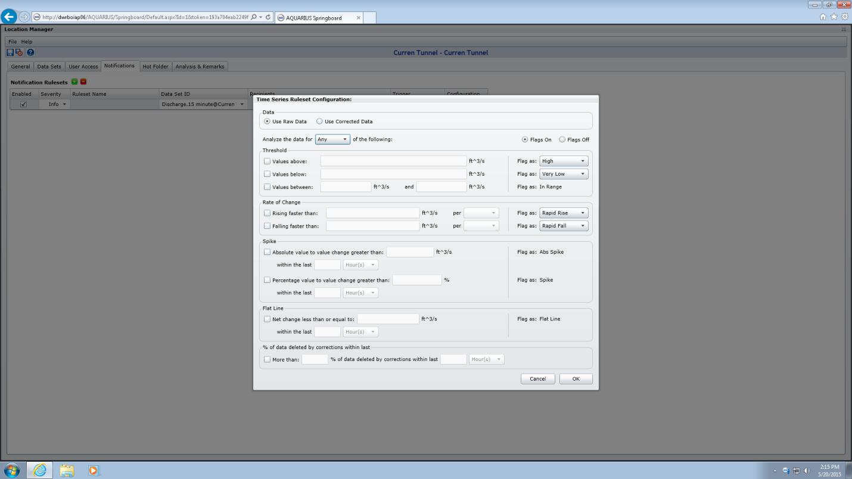
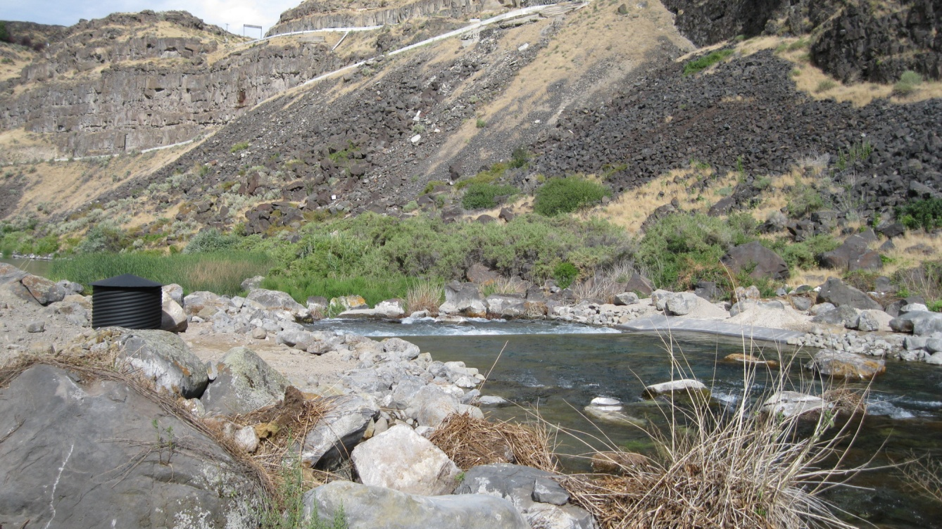
Benefits Continued
Alerts staff of site problems for quicker resolution through the use of email notifications
Keeps managers and clients informed via automated email reports
Email notifications set-up
Notes:
3) Benefits Continued
A couple more benefits. In Aquarius Server, you can use the form shown on the left here to be notified by email of site issues. For example you can be notified of a drop in battery voltage below a minimum value, a sudden rise or fall in water level, or some other equipment failure, such as a flat-line signal. Then, you can act quickly to fix the station rather than losing data until your next planned site visit.
Another great feature is that you can keep everyone informed by having reports automatically sent to specified users. In our case, state and federal hatcheries request their data monthly, so we can have automatic reports sent to them using premade report templates.

Slide 20
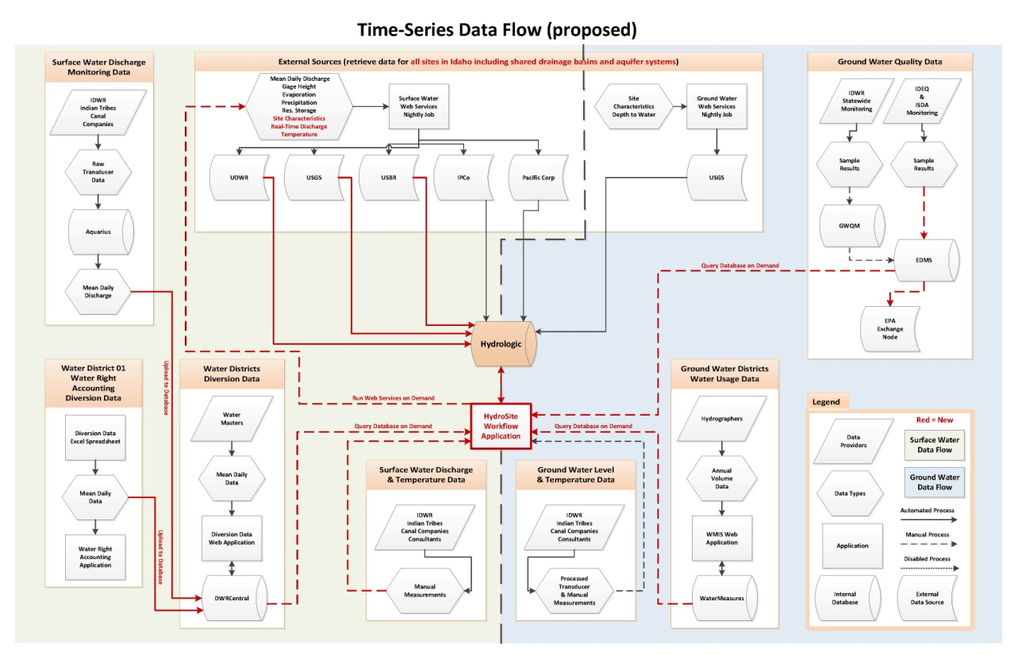
Problems Encountered
Department-wide communication necessary to get all pieces of the puzzle working together → slow, but steady progress
Very time consuming to convert all sites previously processed in Excel and Workstation to Server
Business processes, the big puzzle
Limitations for loading data into Aquarius via Hot Folders – 24 hours of compiled 15 minute data loaded nightly and staggered;
(API also an option)
Notes:
4) Problems Encountered
We have encountered some obstacles along the way, and the first of those is not so much a problem as it is a take-away. It has taken Department-wide communication to sort out how Aquarius Server and the telemetry data fit in with all of our other business processes.
The diagram on the left is just one iteration.
The second issue is that we used Workstation for so long (7 years) as a stand-alone program, that now we have a lot of converting to do from Workstation to Server. We’re also converting from Excel to Workstation. And all of this is very time-consuming.
The third issue we ran into is a limitation with Hot Folders, which is how we drop our data into the program each night. The program bogs down if you drop too much data too frequently. The limit is no more than 30 sites dropped at once and not more than a few times a day.
We could instead use a fancy API (Application Program Interface). The telemetry data would go straight to a database, and Aquarius would recognize additions for further processing, but we decided to go the simple route.

Slide 21
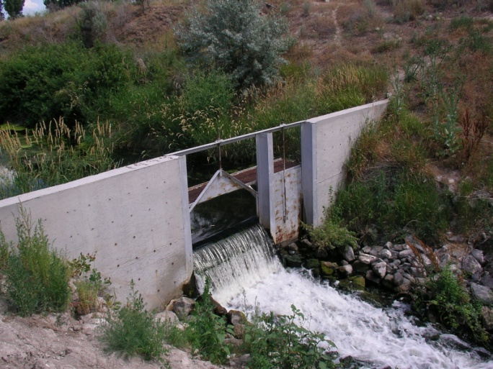
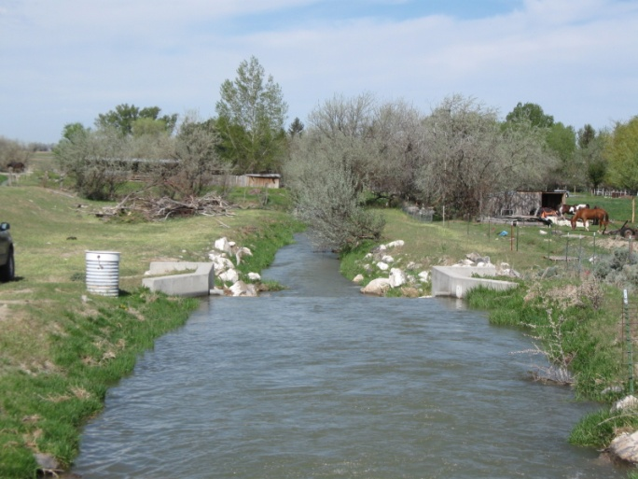
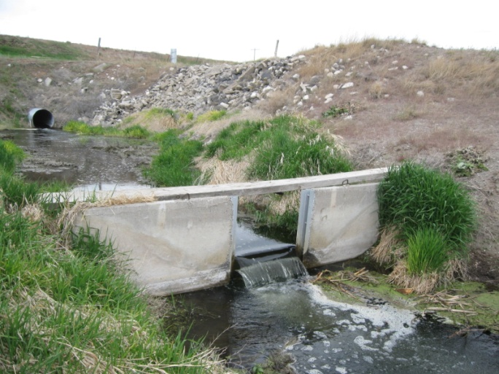
Solutions – Data Flow
Unprocessed real time data automatically goes straight to web for some partners (irrigation districts and Idaho Power Company)
And simultaneously:
Step 1
Within IDWR, nightly drops of 15 minute data to Aquarius for each site
Step 2
Aquarius Server automatically appends -
15 minute water level 15 minute flow daily flow
Step 3
Automatically updates hydrographs of water level and flow and does some basic QA (filling gaps)
Notes:
5) Solutions – Data Flow
So the process we have decided on for data flow is as follows:
A portion of the raw, unprocessed data will go straight to a website for specific partners (Idaho Power Company and a few irrigation districts).
Simultaneously, we’ll do nightly drops of the day’s 15 minute data into Aquarius .
Step 2 – Behind the scenes, Aquarius Server will automatically append the 15 minute water level data, convert it to 15 minute flow data, and then convert that to daily flow.
Step 3 – Aquarius will also automatically generate hydrographs of water level and flow, and it will and do some basic QA, such as gap-filling. Through Step 3, I still haven’t touched the data.

Slide 22
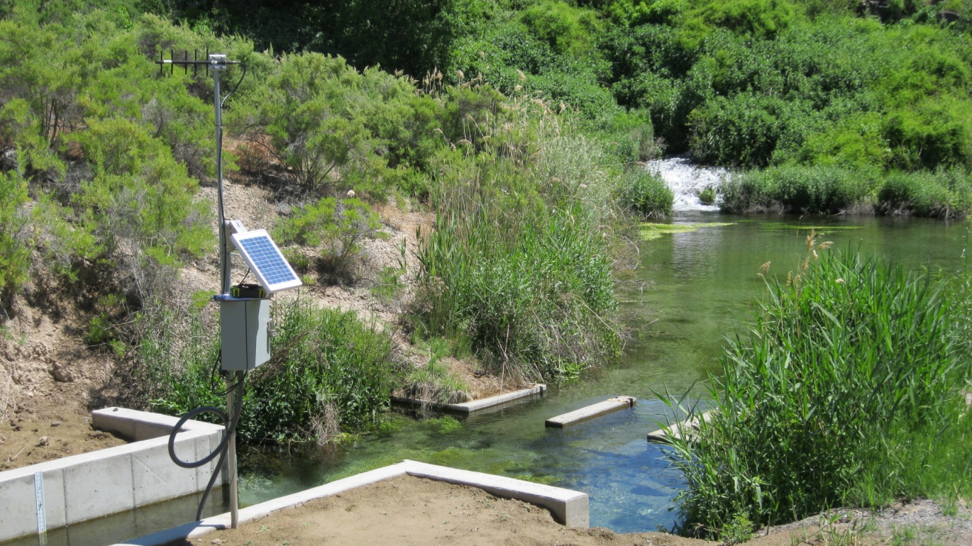
Solutions – Data Flow (cont.)
Step 4
User conducts a more personal QA review requiring judgment and manually approves data
Step 5
Approved data gets kicked over nightly to our database for internal access and automated reports are generated for our partners
Notes:
6) Solutions – Data Flow Continued
Step 4 – is where I come in and do QA requiring judgment, and I when I’m satisfied, I can approve the data.
Step 5 – All approved data gets kicked over to our database for internal access and automated reports are generated for other agencies

Slide 23
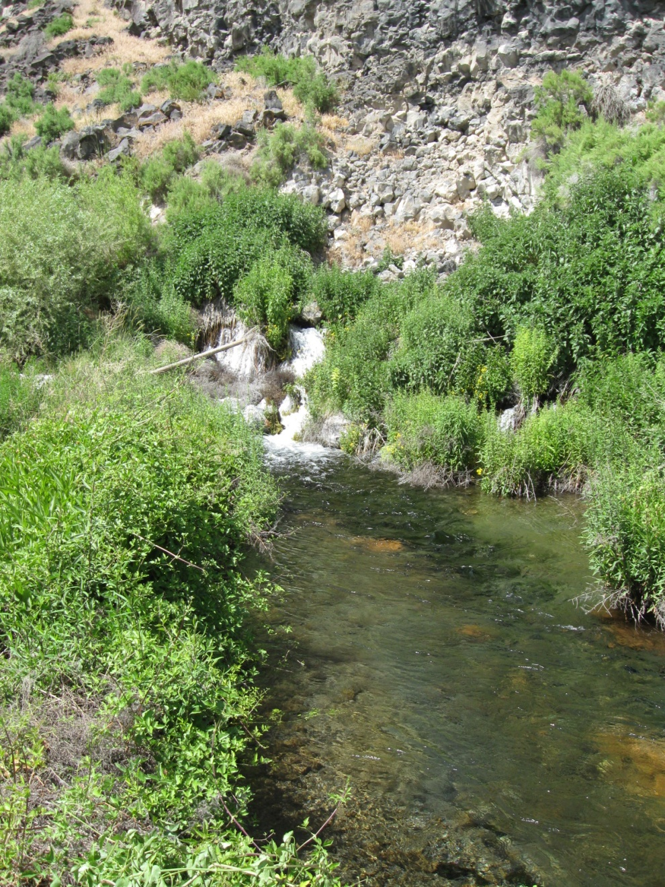
As we spring forward…
Explore posting processed data to web for general public
Consider adding pre-existing sites to telemetry network
Supply high quality data to internal and external customers
Notes:
7) As We Spring Forward…
Moving into the future, we will explore posting more of our data on the web for the general public.
We’ll consider adding some pre-existing sites to our telemetry network.
We’ll be supplying high quality data to both internal and external folks.
Data used internally for:
Ground water model calibration
Water rights accounting
Reach gains/losses calculations
Supply our partners and irrigation districts

